Slide 1
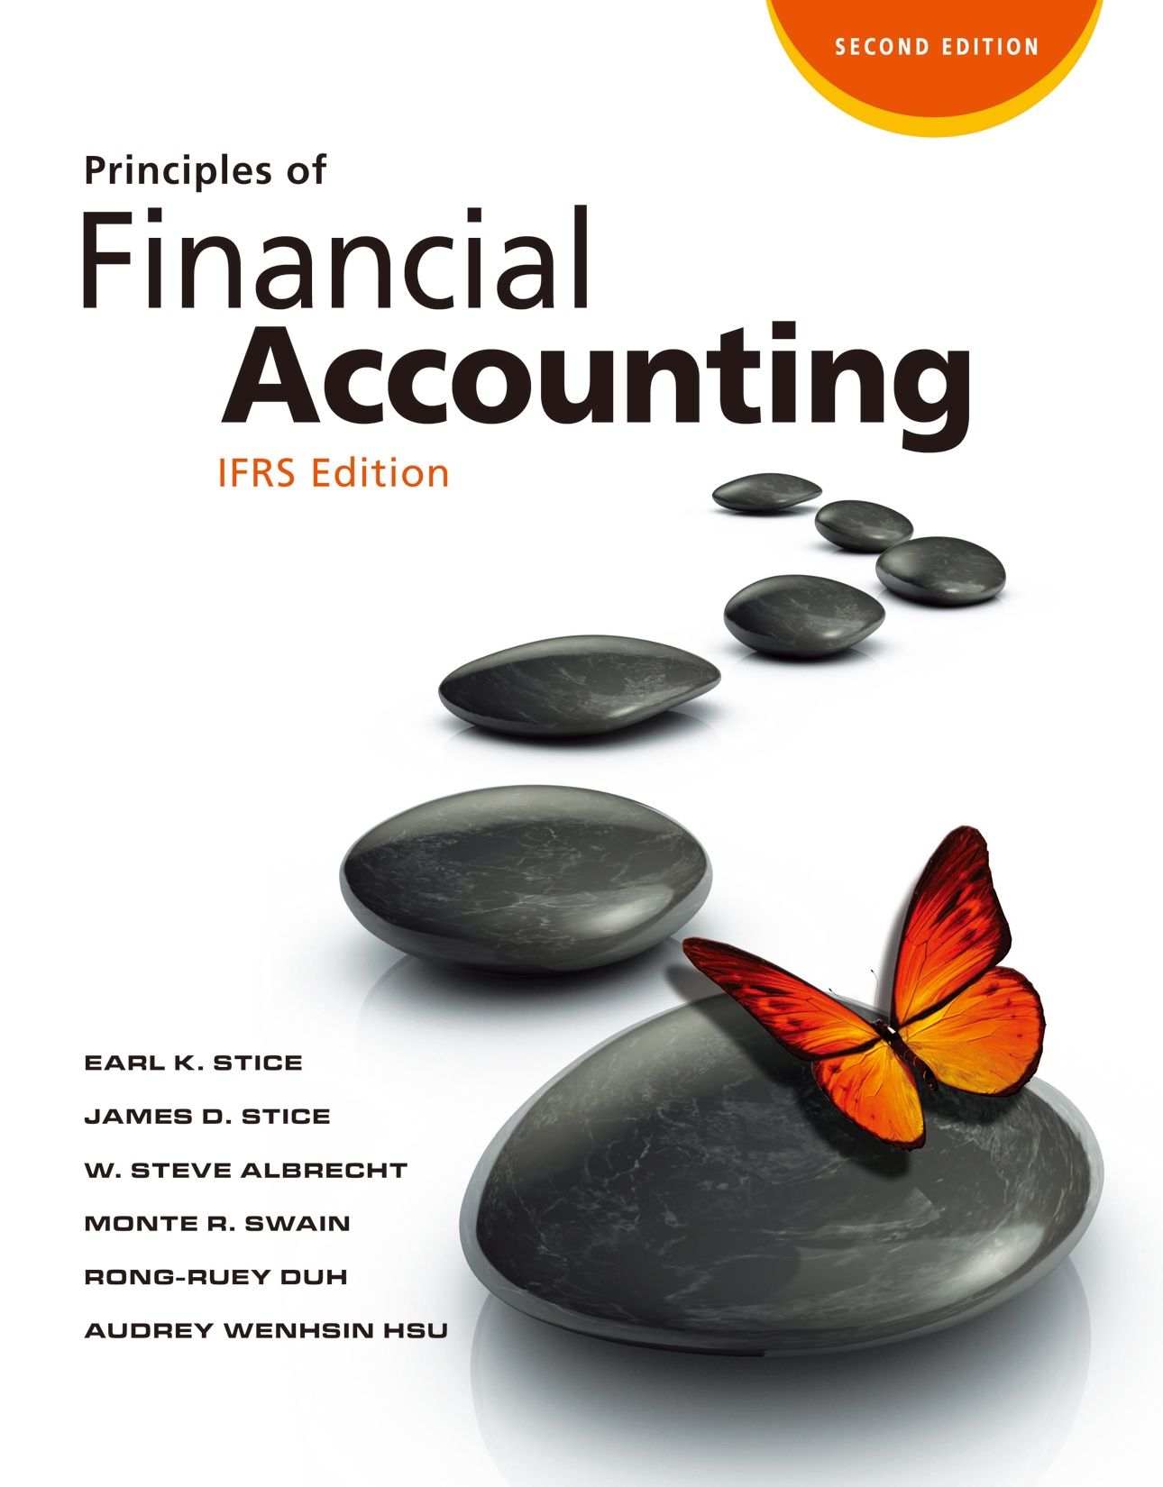

Slide 2
Investments: Debt and Equity Securities

Slide 3
Investments: Debt and Equity Securities

Slide 4
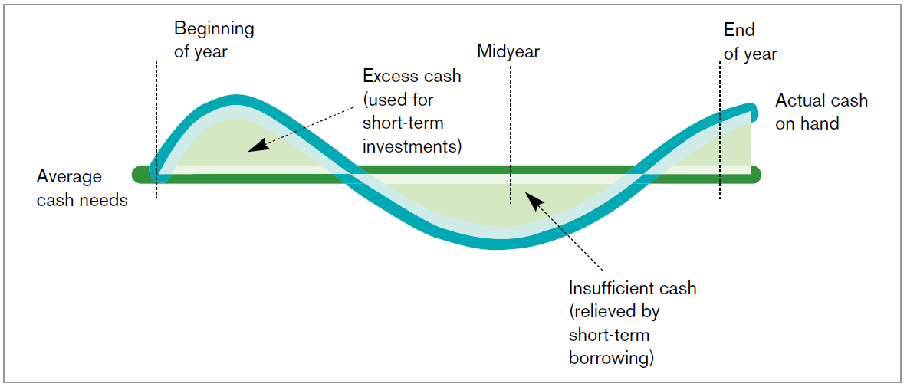
Earning a Return on Excess Cash
Why Companies Invest in Other Companies?
LO1
A Cash Flow Pattern
Exhibit 12.3

Slide 5
Strategic Purpose
LO1
To purchase strategic resources.
To influence or even control another company’s operating decisions.
To diversify its product offerings.
Sometimes it is cheaper for one company to buy all or part of another company that has already expended the time and effort to develop the desired product or know-how.

Slide 6
Debt and Equity Securities
Classifying a Security
LO2
Debt Securities
Financial instruments that carry the promise of interest payments and the repayment of principal.
E.g. Bonds.
If the issuing corporation gets into financial difficulty, investors in corporate debt securities have priority over investors in equity securities.

Slide 7
Debt and Equity Securities
LO2
Equity Securities (Stock)
Shares of ownership in a corporation that can change significantly in value and that provide for a return to investors in the form of dividends.
Holders can vote.
Owners of shares can receive dividends.
Stockholders anticipate an increase in stock price.

Slide 8
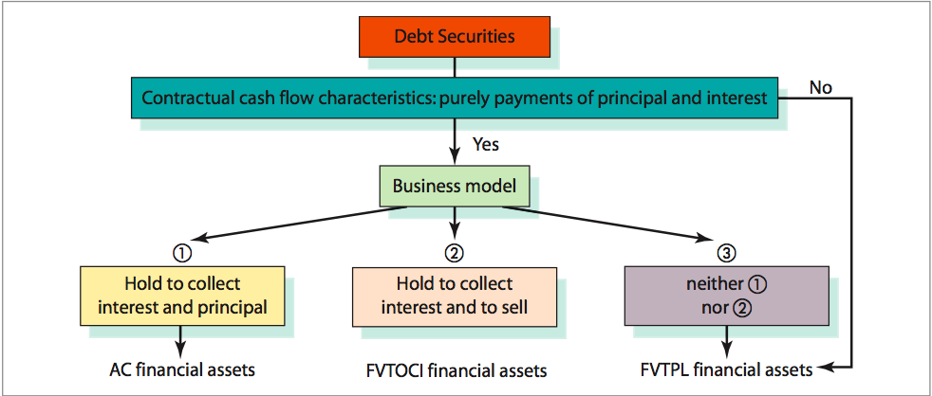
Classification of Financial Assets
LO2
Classifications of Debt Securities
Exhibit 12.4

Slide 9
Classification of Financial Assets
LO2
Amortized Cost (AC) Financial Assets
Debt Securities for which the investors holds primarily to collect the interest and principal and is measured at amortized cost.
FVTOCI Financial Assets-Debt
Debt Securities that are held to collect interest and to sell before maturity, measured as fair value

Slide 10
Classification of Financial Assets
LO2
FVTPL Financial Assets-Debt
Debt Securities that are not classified as either amortized cost (AC) or fair value through other comprehensive income (FVTOCI) are FVTPL financial assets

Slide 11
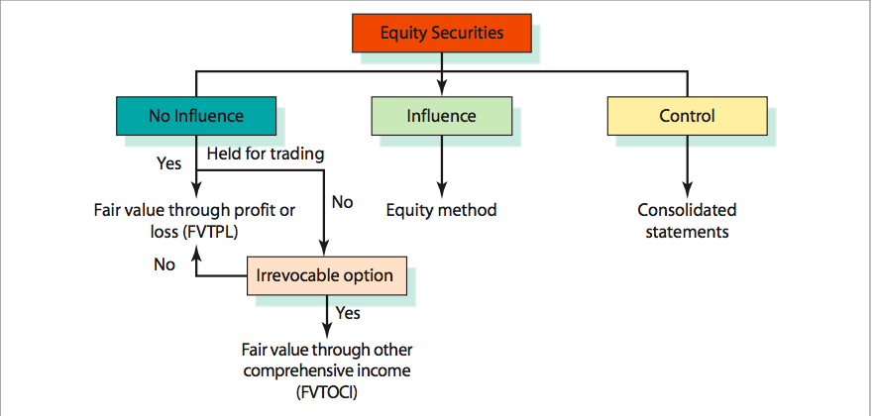
Classification of Financial Assets
LO2
Classifications of Equity Securities
Exhibit 12.5

Slide 12
Classification of Financial Assets
LO2
FVTPL Financial Assets-Equity
Equity Securities that are held for the trading purpose
Equity Securities that are not held for the trading, but the investor do not make an irrevocable option to classified the investment as FVTOCI financial assets

Slide 13
Classification of Financial Assets
LO2
FVTOCI Financial Assets-Equity
Equity Securities for which the investor holds not for the trading purpose but makes an irrevocable option to classify them as FVTOCI

Slide 14
Classification of Financial Assets
LO2
Investments in Associates (Using the Equity Method)
When an investor has significant influence but not control over an investee, the investee is an associate.
IAS 28 require the use of the equity method in accounting for the investment.
Significant influence is presumed with a shareholding of between 20% and 50% of the voting rights.
IAS 28 has suggested that companies look beyond ownership percentage and examine other factors that indicate influence.

Slide 15
Classification of Financial Assets
LO2
Investments Requiring Preparation of Consolidated Statements
A controlling interest is presumed to exist when the ownership exceeds 50%, or other factors that may indicate control exist, including:
Ownership of a large minority voting interest (approximately 40%) with no other group owning a significant interest.
A company’s domination of the process for electing the investee’s board of directors.
In cases where control exists, the parent company (the acquiring company) and the subsidiary company (the acquired company) are required to combine their financial statements into one set of statements.

Slide 16
Quiz Yourself
LO2
Determine whether the securities below should be classified as equity method, amortized cost, FVTOCI, or FVTPL:
Equity securities held to make money on short-term price changes
Equity securities held to exert significant influence on the investee
FVTPL Financial Assets-equity
Investments Accounted for Using Equity Method

Slide 17
Quiz Yourself
LO2
Securities not held under the business model to collect interest and principal, but under the business model to hold to collect interest and to sell.
Securities held to collect interest and principal.
Equity securities not held to make money on trading purpose, and not held to exert significant influence on the investee. A company does not choose to measure the securities at fair value through other comprehensive income.
FVTOCI Financial Assets-Debt
Amortized Cost Financial Assets
FVTPL Financial Assets-Equity

Slide 18
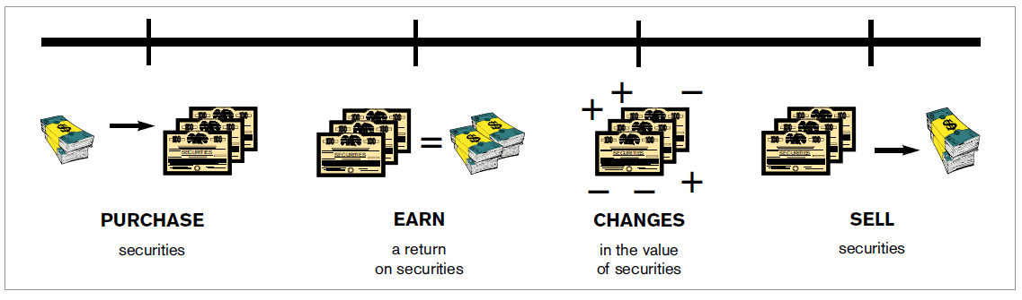
Accounting for Securities Investments
The Amortized Cost Financial Assets
LO3
Business Issues Associated with Buying and Selling Securities
Exhibit 12.6

Slide 19
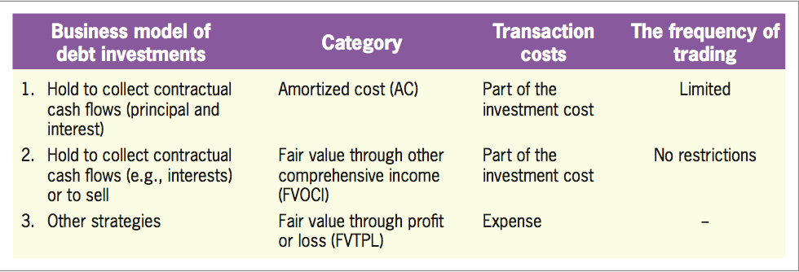
Accounting for Securities Investments
LO3
Business Model of Debt Investments
Exhibit 12.7

Slide 20
Purchase of AC Financial Assets
LO3
Determining the Issuance Price of Bonds
Above face value (at a premium)
Below face value (at a discount)
At face value (at par)
Determining the Cost of Bonds
Actual price paid for the bonds.
Any other purchasing expenditure, such as commissions or broker’s fees.

Slide 21
Purchase of AC Financial Assets
LO3
Illustration
Eastmen Co. purchased 20 NT$1,000 bonds of Formosa Chemicals and classified it as amortized cost financial asset.
The bonds were issued on January 1, 2018, and will mature five years from the date of issuance.
The bonds will pay interest at a stated annual rate of 12%, with payments to be made semiannually on January 1 and July 1.
Assuming the market rate on bonds of similar risk is 12% as well.

Slide 22
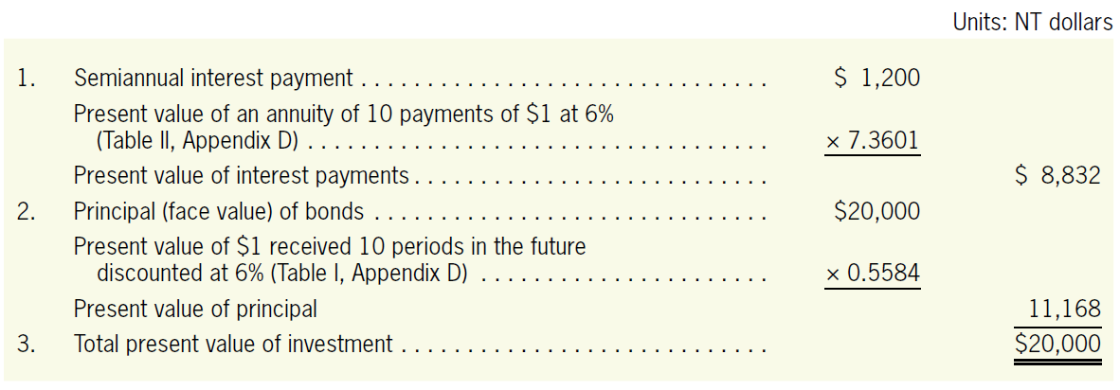
Purchase of AC Financial Assets
LO3
Illustration
The purchase price of the bonds

Slide 23
Purchase of AC Financial Assets
LO3
Illustration
The entry for recording the purchase of the security on January 1, 2018 is:
Jan. 1,
2018
Amortized Cost Financial Assets, Formosa Chemicals
20,000
Cash
20,000
To record purchase of bonds at par.

Slide 24
Investment Revenue
LO3
Illustration
NT$20,000 × 12% × 6/12 months = NT$1,200
July. 1,
2018
Cash
1,200
Interest Revenue
1,200
To record receipt of interest.
Dec. 31,
2018
Bond Interest Receivable
1,200
Interest Revenue
1,200
To record the accrued interest.
Jan. 1,
2019
Cash
1,200
Bond Interest Receivable
1,200
To record the receipt of accrued interest.

Slide 25
No adjustment of AC Financial Assets to Fair Value
LO3
Illustration
On December 31, 2019, the market value of bonds is NT $21,000. But, AC financial assets are not adjusted to their fair values at each reporting date.
No Adjustments of AC Financial Assets to Fair Values

Slide 26
Maturity of AC Financial Assets
LO3
Illustration
Assume that Eastmen holds the bonds until maturity date of January 1, 2023.
Jan. 1,
2023
Cash
20,000
Amortized Cost Financial Assets, Formosa Chemicals
20,000
To record receipt of face amount on maturity.

Slide 27
Purchase between Interest Dates
LO3
Has to pay for the interest that has accrued since the last interest payment date.
Illustration
Assume that Eastmen Co. purchased the Formosa Chemicals bonds in the secondary market for NT$20,000 on May 1, 2018.(See Exhibit 12.8 next page)
May. 1,
2018
Amortized Cost Financial Assets, Formosa Chemicals
20,000
Bond Interest Receivable
800
Cash
20,800

Slide 28
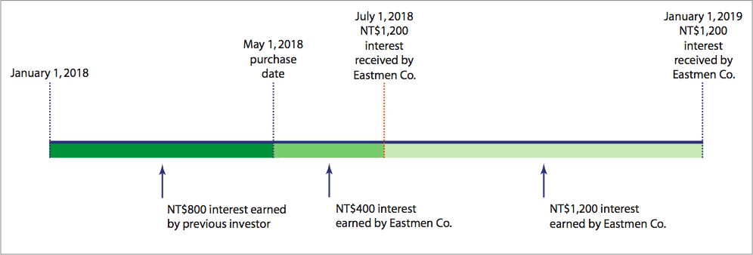
Purchase between Interest Dates
LO3
Illustration
Investing between Interest Dates
Exhibit 12.8

Slide 29
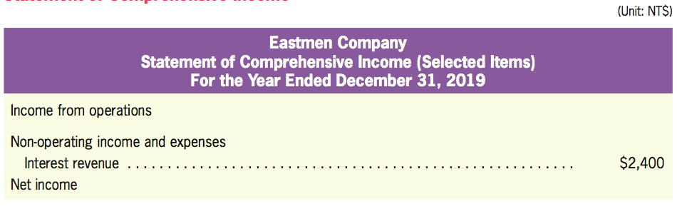
Financial Statement Presentation
LO3
Statement of Comprehensive Income

Slide 30
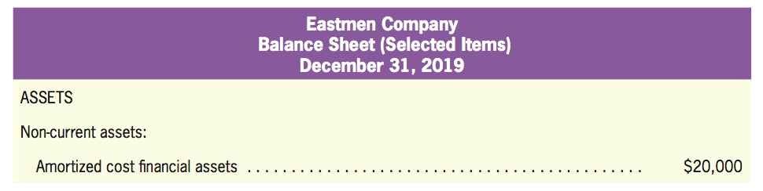
Financial Statement Presentation
LO3
The Balance Sheet
When the maturity date is within one year, the amortized cost financial assets should be reclassified as current assets.

Slide 31
Quiz Yourself
LO3
On January 1, 2018, Lily Company issued bonds with a coupon rate of 10% and a face amount of $1,000.
The bond interest payments are made at the end of each year on December 31.
The bonds mature in eight years.
The market interest rate for bonds with the same degree of risk is 10%.
Investor A purchased ALL of these bonds on the issuance date, and hold the bonds purely to collect the interest and principal.

Slide 32
Quiz Yourself
LO3
Make the journal entry needed on Investor A’s books to record the purchase of the Lily Company bonds.
Make the journal entry needed on Investor A’s books to record the receipt of the first interest payment.
Jan. 1,
2018
Amortized Cost Financial Assets, Lily Company
1,000
Cash
1,000
Dec. 31,
2018
Cash
100
Interest Revenue
100

Slide 33
Quiz Yourself
LO3
Make the journal entry needed on Investor A’s books to record the receipt of the second interest payment.
Make the journal entry needed on Investor A’s books to record the receipt of the final interest payment and the collection of the principal at the maturity date.
Dec. 31,
2019
Cash
100
Interest Revenue
100
Dec. 31,
2025
Cash
1,100
Interest Revenue
100
Amortized Cost Financial Assets, Lily Company
1,000

Slide 34
Purchase of FVTOCI Financial Assets-Debt
Debt Investments: Fair Value through Other Comprehensive Income (FVTOCI) Financial Assets—Debt
LO4
FVTOCIs are initially measured at cost, which is the fair value of whatever was paid to buy the financial assets.
Transaction costs directly attributable to the purchase of financial assets should be included as investment costs.

Slide 35

Purchase of FVTOCI Financial Assets-Debt
LO4
Illustration
On January 2, 2018, Oriental Co. purchased one bond issued by WMD Inc.
The initial entry to record the investments is as follows:
Jan. 2,
2018
FVTOCI Financial Assets—Debt
17,000
Cash
17,000

Slide 36
Investment Revenue
LO4
Interest Incomes
For FVTOCI financial assets—debt, cash interest received periodically are recognized as interest revenue.

Slide 37
Investment Revenue
LO4
Illustration
Assume that WMD Inc. paid interest of £850 on July 1, 2018 to Oriental Co.
The appropriate journal entries to record the receipt of interest is:
July. 1,
2018
Cash
850
Interest Revenue
850

Slide 38
Adjustment of FVTOCI Financial Assets Debt to Fair Values
LO4
Valuation
Changes in value are not included in net income but are recognized as an equity
Unrealized Gains or Losses on FVTOCI Financial Assets
An other comprehensive income (OCI)
The balance should be carried forward from period to period until the financial assets are sold.

Slide 39
Adjustment of FVTOCI Financial Assets to Fair Value
LO4
Illustration
At the end of 2018, Oriental computed the market value of its available-for-sale financial assets and compared the market value to the historical cost.

Slide 40
Adjustment of FVTOCI Financial Assets to Fair Value
LO4
Illustration
The journal entries to record the changes in fair value:
Dec. 31,
2018
Valuation Adjustment for FVTOCI Financial Assets—Debt
1,000
Unrealized Gains or Losses on FVTOCI Financial Assets—Debt
1,000

Slide 41
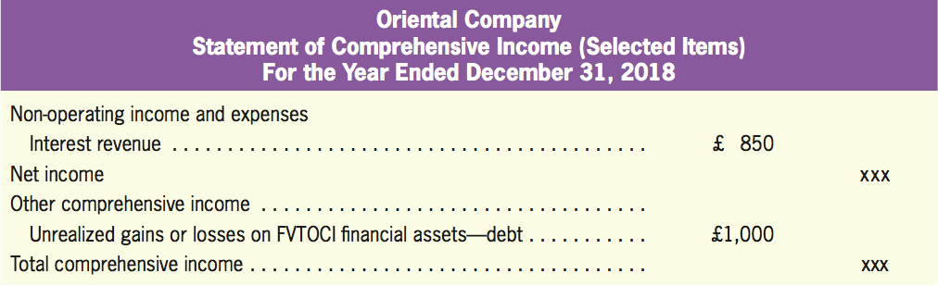
Financial Statement Presentation
LO4
Statement of Comprehensive Income

Slide 42
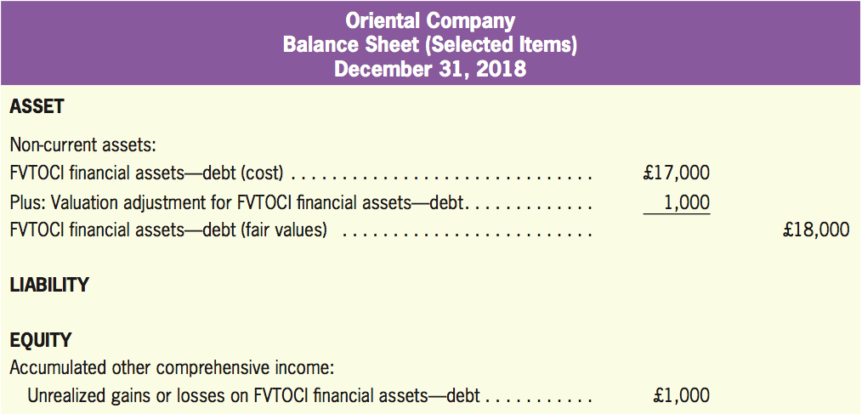
Financial Statement Presentation
LO4
Balance Sheet

Slide 43
Financial Statement Presentation
LO4
Illustration
To further illustrate, assume that Oriental still held the bonds and the stock at the end of 2019, at which the market value of bonds increased from £18,000 to £18,250. There were no additional security investments in 2019.
The other comprehensive income for 2019 is £250.
But the accumulated other comprehensive income becomes £1,250 (£1000 + £250 = £1,250).

Slide 44
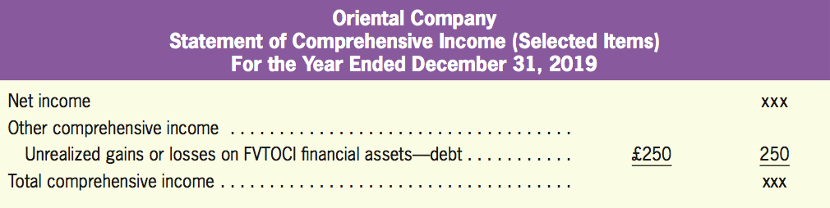
Financial Statement Presentation
LO4
Statement of Comprehensive Income

Slide 45
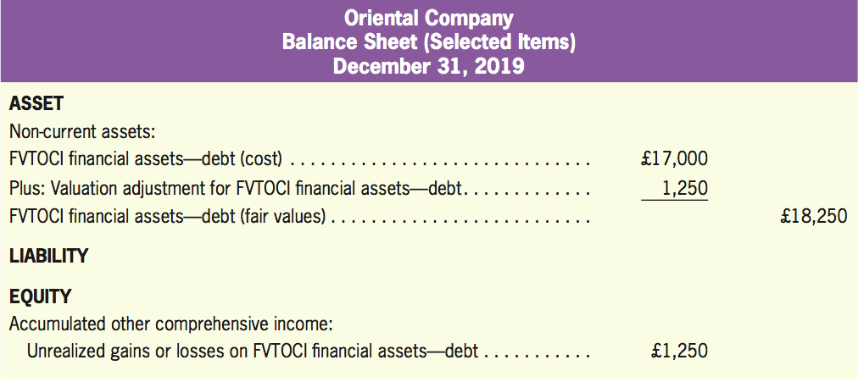
Financial Statement Presentation
LO4
Balance Sheet

Slide 46
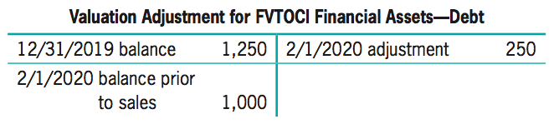
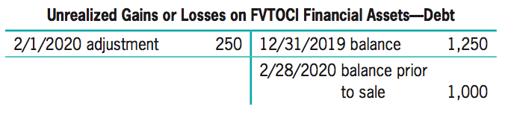
Sale of AFS Financial Assets
LO4
Illustration
Suppose that Oriental sold all WMD bonds for £18,000 on February 1, 2020.
Feb. 1,
2020
Unrealized Gains or Losses on FVTOCI Financial Assets—Debt
250
Valuation Adjustment for FVTOCI Financial Assets—Debt
250
200

Slide 47
Sale of AFS Financial Assets
LO4
Illustration
Since the company has disposed all WMD stock, we need to close the unrealized gains or losses on FVTOCI financial assets-Debt in the equity section by reclassifying £1,000 under net income.
Feb. 1,
2020
Cash
18,000
Valuation Adjustment for FVTOCI Financial Assets—Debt
1,000
FVTOCI Financial Assets—Debt
17,000
Feb. 1,
2020
Unrealized Gains or Losses on FVTOCI Financial Assets—Debt
1,000
Gain From Sale of FVTOCI Financial Assets—Debt
1,000

Slide 48
Quiz Yourself
LO4
Stefan Company has a large portfolio of FVTOCI financial assets-debt. The entire portfolio was purchased on January 1 of 2018 for £500,000. The total market value of the securities in the portfolio was as follows on the indicated dates:
Make the journal entries required to record the purchase of the securities and the changes in value during 2018 and 2019.
1 | December 31, 2018: £575,000.
2 | December 31, 2019: £430,000.
3 | Stefan sold all securities on December 31, 2019.

Slide 49
Quiz Yourself
LO4
Solution
Jan. 1,
2018
FVTOCI Financial Assets—Debt
500,000
Cash
500,000
Dec. 31,
2018
Valuation Adjustment for FVTOCI
Financial Assets—Debt
75,000
Unrealized Gains or Losses on
FVTOCI Financial Assets—Debt
75,000

Slide 50
Quiz Yourself
LO4
Solution
Dec. 31,
2019
Unrealized Gains or Losses on
FVTOCI Assets—Debt
145,000
Valuation Adjustment for FVTOCI Financial Assets—Debt
145,000
Dec. 31,
2019
Cash
430,000
Valuation Adjustment for FVTOCI Financial Assets—Debt
70,000
FVTOCI Financial Assets—Debt
500,000
Dec. 31,
2019
Losses From Sale of FVTOCI
Financial Assets—Debt
70,000
Unrealized Gains or Losses on
FVTOCI Financial Assets—Debt
70,000

Slide 51
Purchase of FVTPL Financial Assets
Fair Value through Profit or Loss (FVTPL) Financial Assets
LO5
FVTPLs are initially measured at cost, which is the fair value of whatever was paid to buy the financial assets.
Transaction costs directly attributable to the purchase of FVTPLs can be included as investment costs, or recognized as expenses as incurred.
In this chapter, we expense transaction costs for FVTPL financial assets.

Slide 52
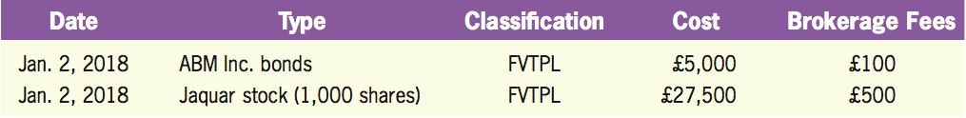
Purchase of FVTPL Financial Assets
LO5
Illustration
On January 2, 2018, Westhood purchased one bond of ABM Inc. and 1,000 shares of Jaquar stock:

Slide 53
Purchase of FVTPL Financial Assets
LO5
Illustration
The initial entry to record the investments is as follows:
Jan. 2,
2018
FVTPL Financial Assets—Debt
5,000
FVTPL Financial Assets—Equity
27,500
Brokerage Fees
600
Cash
33,100

Slide 54
Investment Revenue
LO5
Dividend (Equity) and Interest (Debt) Incomes
For FVTPL financial assets—equity, cash dividends received during the investment periods are recognized as dividend revenue.
For FVTPL financial assets—debt, cash interest received periodically are recognized as interest revenue.

Slide 55
Investment Revenue
LO5
Illustration
Assume that ABM Inc. paid interest of £225 on July 1, 2018 to Westhood and Jaquar paid dividends of £825 to Westhood on November 11, 2018.
The appropriate journal entries to record the receipt of interest and dividends are:
July. 1,
2018
Cash
225
Interest Revenue
225
Nov. 11,
2018
Cash
825
Dividend Revenue
825

Slide 56
Adjustment of FVTPL Financial Assets to Fair Values
LO5
Valuation
FVTPLs are remeasured at fair value, subsequently with changes in fair value recognized in profit or loss.
Valuation Adjustment for FVTPL Financial Assets.

Slide 57
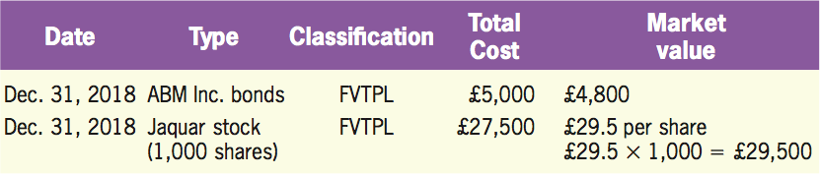
Adjustment of FVTPL Financial Assets to Fair Values
LO5
Illustration
At the end of 2018, Westhood computed the market value of its FVTPL financial assets and compared the market value to the historical cost.

Slide 58
Adjustment of FVTPL Financial Assets to Fair Value
LO5
Illustration
The journal entries to record the changes in fair value:
Dec. 31,
2018
Losses on FVTPL Financial Assets—Debt
200
Valuation Adjustment for FVTPL Financial Assets—Debt
200
Dec. 31,
2018
Valuation Adjustment for FVTPL Financial Assets—Equity
2,000
Gains on FVTPL Financial Assets—Equity
2,000

Slide 59
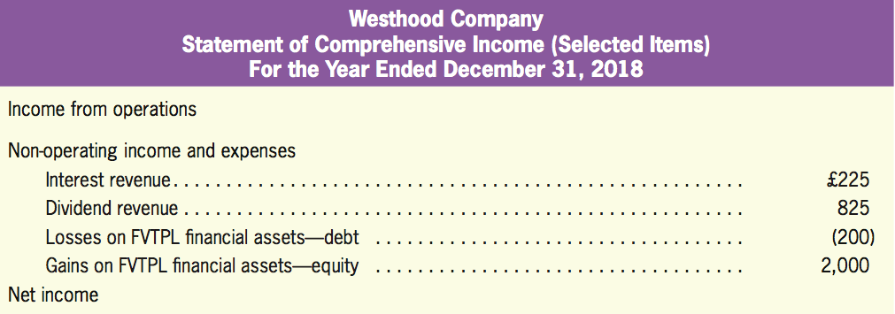
Financial Statement Presentation
LO5
Statement of Comprehensive Income

Slide 60
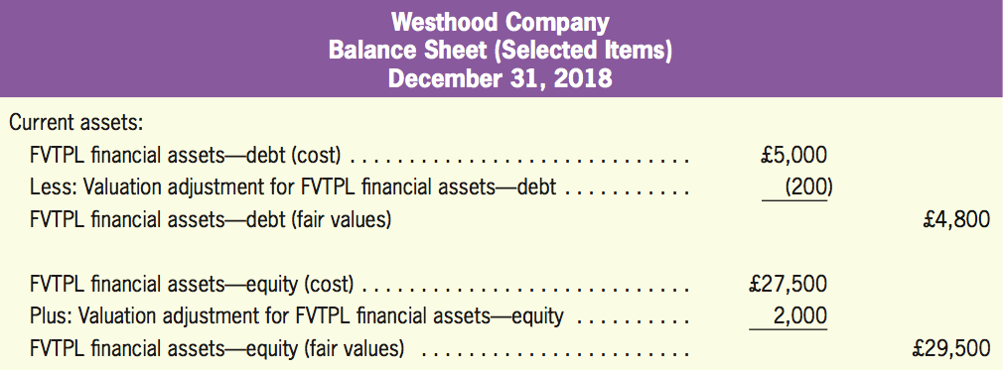
Financial Statement Presentation
LO5
Balance Sheet

Slide 61
Sale of FVTPL Financial Assets
LO5
Illustration
Suppose that Westhood sold all of its investment in debts for £5,200 on March 15, 2019.
Mar. 15,
2019
Valuation Adjustment for FVTPL Financial Assets—Debt
400
Gains on FVTPL Financial Assets—Debt
400
Mar. 15,
2019
Cash
5,200
FVTPL Financial Assets—Debt
5,000
Valuation Adjustment for FVTPL Financial Assets—Debt
200
200
400
200

Slide 62
Quiz Yourself
LO5
Using the characteristics of Security A below, make all journal entries necessary in 2018 to account for the purchase, recognition of interest revenue, and sale of Security A.
1 | Purchased Security A (FVTPL) for $1,000 on January 1, 2018.
2 | Security A is a debt security.
3 | Annual interest rate on Security A is 8%.
4 | Received annual interest, in cash, on December 31, 2018.
5 | On December 31, 2018, after receiving interest, Security A is valued for $950.
6 | On January 3, 2019, sell security A at market value $955.

Slide 63
Quiz Yourself
LO5
Solution
Jan. 1
FVTPL Financial Assets—Debt, Security A
1,000
Cash
1,000
Dec. 31
Cash
80
Interest Revenue
80
Dec. 31
Losses on FVTPL Financial Assets—Debt, Security A
50
Valuation Adjustment for FVTPL Financial Assets—Debt, Security A
50

Slide 64
Quiz Yourself
LO5
Solution
Jan. 3
Valuation Adjustment for FVTPL Financial Assets—Debt, Security A
5
Gains on FVTPL Financial Assets—Debt, Security A
5
Jan. 3
Cash
955
Valuation Adjustment for FVTPL Financial Assets—Debt, Security A
45
FVTPL Financial Assets—Debt, Security A
1,000

Slide 65
FVTOCI Financial Assets-Equity
Equity Investments: Fair Value through Other Comprehensive Income (FVTOCI) Financial Assets—Equity
LO6
Unrealized gains or losses recognized in other comprehensive incomes are never reclassified from equity to profit or losses.
The mechanics of FVTOCI category for debt instruments (See LO4) is different from FVTOCI category for equity instruments because the amounts recognized in OCI for debt instruments can be reclassified to profit or losses.
FVTOCI-Equity are initially recorded at cost, including transactions costs directly attributable to the purchase of securities (e.g. brokerage fees)

Slide 66
Purchase of FVTOCI Financial Assets-Debt
LO6
Illustration
On January 2, 2018, Oriental Co. purchased 1,000 shares of BGC stock
The initial entry to record the investments is as follows:
Jan. 2,
2018
FVTOCI financial assets—Equity
9,200
Cash
9,200

Slide 67
Investment Revenue
LO6
Dividend
For FVTOCI financial assets—equity, cash dividends received during the investment periods are recognized as dividend revenue.

Slide 68
Investment Revenue
LO6
Illustration
Assume that. BGC paid dividends of £644 to Oriental Co. on November 15, 2018.
Nov. 15,
2018
Cash
644
Dividend Revenue
644

Slide 69
Adjustment of FVTOCI Financial Assets-Equity to Fair Values
LO6
Valuation
Changes in value are not included in net income but are recognized as an equity
Unrealized Gains or Losses on Available-for-Sale Financial Assets
An other comprehensive income (OCI)
The balance should be carried forward from period to period until the financial assets are sold.

Slide 70
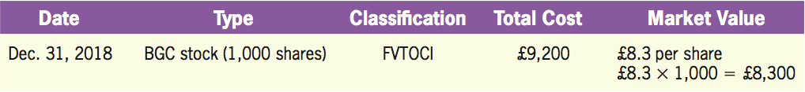
Adjustment of FVTOCI Financial Assets-Equity to Fair Values
LO6
Illustration
At the end of 2018, Oriental computed the market value of its available-for-sale financial assets and compared the market value to the historical cost.

Slide 71
Adjustment of FVTOCI Financial Assets-Equity to Fair Values
LO6
Illustration
The journal entries to record the changes in fair value:
Dec. 31,
2018
Unrealized Gains or FVTOCI Financial Assets—Equity
900
Valuation Adjustment for FVTOCI
Financial Assets—Equity
900

Slide 72
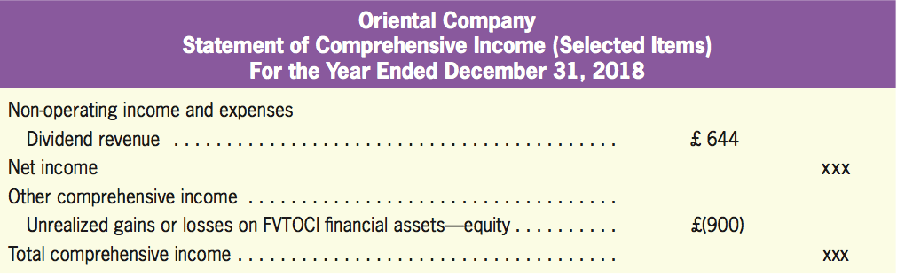
Financial Statement Presentation
LO6
Statement of Comprehensive Income

Slide 73
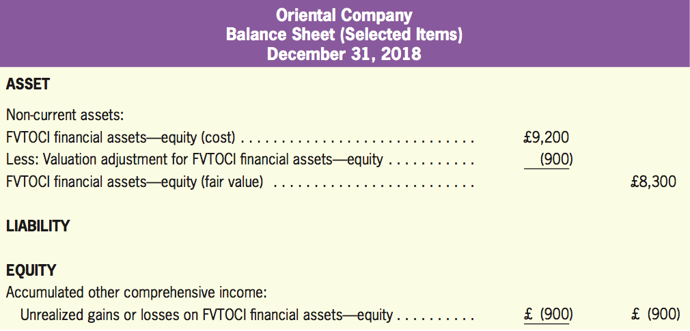
Financial Statement Presentation
LO6
Balance Sheet

Slide 74
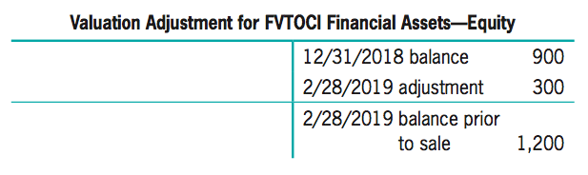
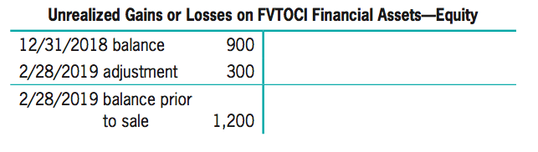
Sale of FVTOCI-Equity Financial Assets
LO6
Illustration
Suppose that Oriental sold 1,000 shares of BGC stock for £8,000 on February 28, 2019.
Feb. 28,
2019
Unrealized Gains or FVTOCI Financial Assets—Equity
300
Valuation Adjustment for FVTOCI Financial Assets—Equity
300

Slide 75
Sale of FVTOCI-Equity Financial Assets
LO6
Illustration
Feb. 28,
2019
Cash
8,000
Valuation Adjustment for FVTOCI
Financial Assets—Equity
1,200
FVTOCI Financial Assets—Equity
9,200

Slide 76
Sale of FVTOCI-Equity Financial Assets
LO6
Illustration
Since the company has disposed all BGC stock, we need to close the unrealized gains or losses on FVTOCI financial assets in the equity section and can not reclassify £1,200 under net income. Instead, we need to close unrealized gains on FVTOCI financial assets-equity to Retained Earnings.
Feb. 28,
2019
Retained Earnings
1,200
Unrealized Gains or Losses on FVTOCI Financial Assets—Equity
1,200

Slide 77
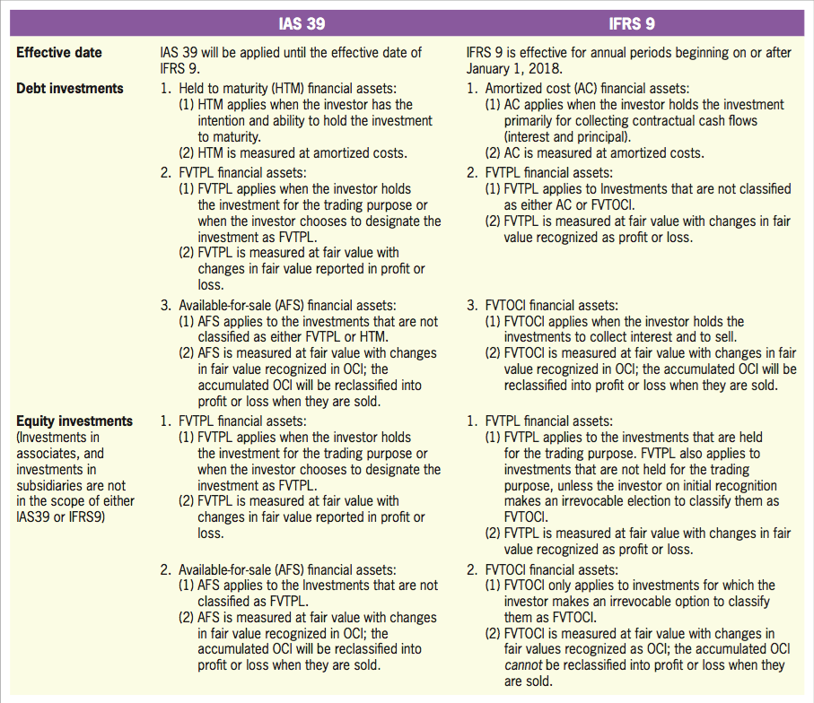
A Comparison between IAS 39 and IFRS9
LO6
Exhibit 12.9

Slide 78
Quiz Yourself
LO6
Stefan makes an irrevocable option to measure the portfolio using FVTOCI. The entire portfolio was purchased on January 1 of 2018 for £500,000. The total market value of the securities in the portfolio was as follows on the indicated dates:
Make the journal entries required to record the purchase of the securities and the changes in value during 2018 and 2019.
1 | December 31, 2018: £575,000.
2 | December 31, 2019: £430,000.
3 | Stefan sold all securities on December 31, 2019.

Slide 79
Quiz Yourself
LO6
Solution
Jan. 1,
2018
FVTOCI Financial Assets—Equity
500,000
Cash
500,000
Dec. 31,
2018
Valuation Adjustment for FVTOCI
Financial Assets—Equity
75,000
Unrealized Gains or Losses on
FVTOCI Financial Assets—Equity
75,000

Slide 80
Quiz Yourself
LO6
Solution
Dec. 31,
2019
Unrealized Gains or Losses on
FVTOCI Financial Assets—Equity
145,000
Valuation Adjustment for FVTOCI Financial Assets—Equity
145,000
Dec. 31,
2019
Cash
430,000
Valuation Adjustment for FVTOCI Financial Assets—Equity
70,000
FVTOCI Financial Assets—Equity
500,000
Dec. 31,
2019
Retained Earnings
70,000
Unrealized Gains or Losses on
FVTOCI Financial Assets—Equity
70,000

Slide 81
Illustrating the Equity Method
Accounting for Investment in Associates Using the Equity Method
LO7
Record purchase: Investments are initially recorded at cost.
Record investment revenues: The investor includes in net income its proportionate share of the investee’s net income.
Record dividends: Dividend distribution is a reduction of the investor’s investments.
Record sales: To recognize gains/losses from the difference between the sale proceeds and the carrying amount of investments.

Slide 82
Purchase of Investment Accounted for Using the Equity Method
LO7
Illustration
Assume that Kimball Inc. purchased 20% (2,000 shares) of Holland Enterprises’ outstanding common stock (10,000 shares), paying €100 per share on January 1, 2018.
Jan. 1,
2018
Investment Accounted for Using the
Equity Method, Holland Enterprises
200,000
Cash
200,000
To record the purchase of 20% equity in Holland.

Slide 83
Investment Revenue
LO7
Illustration
Holland Enterprises announces net income for 2018 of €50,000.
Under the equity method, revenue is recognized when the investee company has earnings.
€50,000 × 20% = €10,000
Dec. 31,
2018
Investment Accounted for Using the
Equity Method, Holland Enterprises
10,000
Shares of Income from Associates
10,000
To record 20% equity in Holland’s 2018 net income.

Slide 84
Dividends Received
LO7
Illustration
Holland Enterprises paid €2.5 per dividend on December 31, 2018.
Under the equity method, dividend payments represent a return of investment; they do not represent revenue.
Dec. 31,
2018
Cash
5,000
Investment Accounted for Using the
Equity Method, Holland Enterprises
5,000
To record dividend received.

Slide 85
No Adjustment to Fair Value
LO7
Temporary changes in value of investments accounted for using the equity method are not recorded.

Slide 86
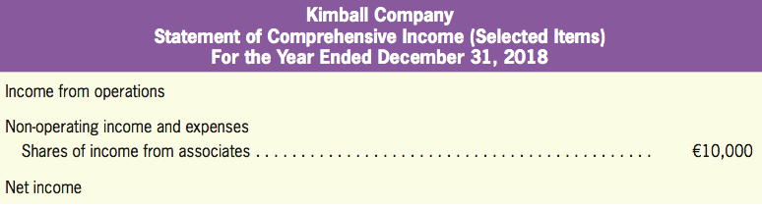
Financial Statement Presentation
LO7
Statement of Comprehensive Income

Slide 87
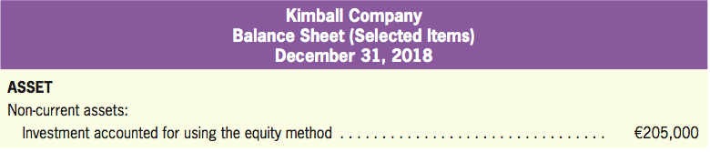
Financial Statement Presentation
LO7
Balance Sheet
£205,000 = €200,000 + €10,000 − €5,000

Slide 88
Sale of the Investment Accounted for Using the Equity Method
LO7
Illustration
Assume that, on January 2, 2019, Kimball sells its 2,000 shares of Holland stock for €225,000 shortly after the year-end recognition of its €10,000 share of Holland’s earnings. The entry to record the sale is:
Jan. 2,
2019
Cash
225,000
Investment Accounted for Using the
Equity Method, Holland Enterprises
205,000
Gains from Sale of Investments in Associates
20,000

Slide 89
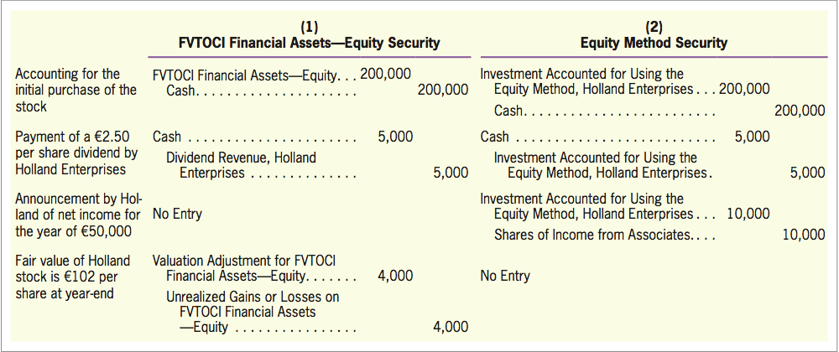
Comparing Equity Method with Fair Value Approach
LO7
Exhibit 12.10

Slide 90
Quiz Yourself
LO7
On January 1, 2018, Taraz Company purchased 4,000 shares of the common stock of Patel Company for $300,000. At the time, Patel had a total of 10,000 common shares outstanding. Accordingly, Taraz purchased 40% of the outstanding shares of Patel.
During 2018, Patel paid cash dividends totaling $50,000 and reported net income of $70,000.

Slide 91
Quiz Yourself
LO7
Make the journal entry necessary on Taraz’s books to record the purchase of the Patel shares.
Jan. 1
Investment Accounted for Using the
Equity Method—Patel Company
300,000
Cash
300,000
Purchased 4,000 shares for $300,000.

Slide 92
Quiz Yourself
LO7
Make the journal entries necessary on Taraz’s books in 2018 to record the receipt of dividends from Patel and to record revenue on the investment.
Cash ($50,000 X 0.40)
20,000
Investment Accounted for Using the
Equity Method—Patel Company
20,000
Investment Accounted for Using the
Equity Method—Patel Company
28,000
Shares of Income from Associates ($70,000 X 0.40)
28,000

Slide 93
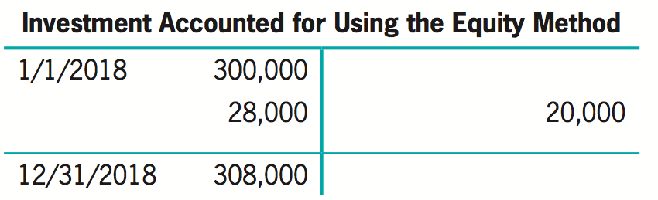
Quiz Yourself
LO7
On Taraz’s books, what amount should be reported as “Investment in Equity Method Securities, Patel Company” as of December 31, 2018?

Slide 94
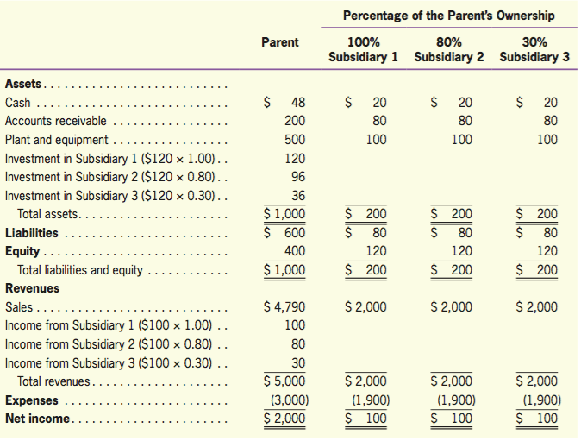
Consolidated Financial Statements*
Consolidated Financial Statements
LO8
Controlled Companies
Using the Equity Method

Slide 95
Consolidated Financial Statements*
LO8
Controlled Subsidiaries
The consolidated balance sheet and statement of comprehensive income include all assets, liabilities, revenues, and expenses of the parent and the subsidiaries it controls.
Even though the parent owns only 80% of Subsidiary 2, all of that subsidiary’s assets, liabilities, revenues, and expenses are included in the consolidated total.

Slide 96
Consolidated Financial Statements*
LO8
Controlled Subsidiaries
The fact the parent owns only 80% of that subsidiary is reflected in the non-controlling interest items.
Non-controlling interest | Non-controlling interest income
Consolidated balance sheet | Consolidated statement of comprehensive income
The amount of equity investment made by outside shareholders to consolidated subsidiaries that are not 100% owed by the parent. | The amount of income belonging to outside shareholders of consolidated subsidiaries that are not 100% owned.

Slide 97
Consolidated Financial Statements*
LO8
Investment in Associates Using the Equity Method
None of the individual assets, liabilities, revenues, and expenses of Subsidiary 3 is included in the consolidated financial statements because that subsidiary is not controlled by the parent.
Instead, the parent’s ownership of 30% of Subsidiary 3 is accounted for using the equity method.

Slide 98
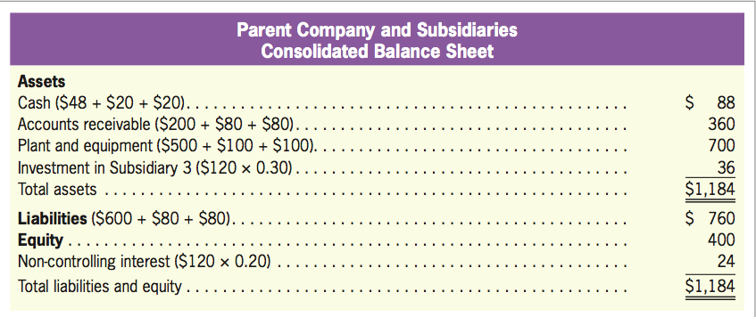
Consolidated Financial Statements*
LO8
Consolidated Balance Sheet
Exhibit 12.11
Equal to the total equity reported by the parent.

Slide 99
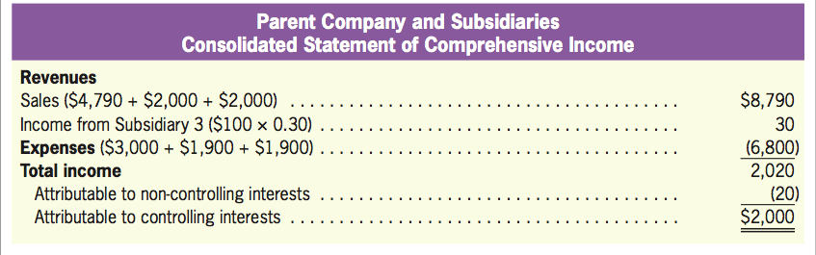
Consolidated Financial Statements*
LO8
Consolidated Statement of Comprehensive Income
Exhibit 12.11

Slide 100
Quiz Yourself
LO8
Refer to the data in Exhibit 12.11. Assume that instead of owning 30% of Subsidiary 3, the parent actually owns 60% of Subsidiary 3. All other data not impacted by that assumption are the same. Using that assumption, answer the following questions.
What is the amount of consolidated total assets?
Consolidated total assets
Cash: $48 + $20 + $20 + $20 = $108
Accounts receivable: $200 + $80 + $80 + $80 = $440
Plant and equipment: $500 + $100 + $100 + $100 = $800
Total assets: $108 + $440 + $800 = $1,348

Slide 101
Quiz Yourself
LO8
What is the amount of consolidated total liabilities?
Consolidated total liabilities: $600 + $80 + $80 + $80 = $840
What is the amount of consolidated sales?
Consolidated sales: $4,790 + $2,000 + $2,000 + $2,000 = $10,790

